Slide 1


DEPARTMENT OF COMPUTER SCIENCE & ENGINEERING
SCHOOL OF COMPUTING
10214CS602 MINOR PROJECT -II
WINTER SEMESTER(2023-2024)
REVIEW-II
“CROP YIELD FORECASTING USING MACHINE LEARNING”
SUPERVISED BY
PRESENTED BY
MRS J.SWAPNA (ASSISTANT PROFESSOR)
1.C.YELLA KRISHNA REDDY (VTU20114) (21UECM0272.)
2.C.YELLA NAGI REDDY (VTU20113) (21UECM0273.)
3.T.SAI KUMAR REDDY (VTU19969) (21UECMO249.)

Slide 2
OVERVIEW
ABSTRACT
OBJECTIVES
TIMELINE OF THE PROJECT
INTRODUCTION
LITERATURE REVIEW
DESIGN AND METHODOLOGIES
IMPLEMENTATION
CONCLUSION
REFERENCES

Slide 3
ABSTRACT
ABSTRACT:
Weather condition plays a major role for the enhancement of yield in agriculture. In this project, Logistic regression algorithm is proposed to predict the weather and to select the suitable crop.
The parameter like temperature, humidity, rainfall, nitrogen, phosphorous, potassium, pH are analysed to predict the weather by which the preferable crops are selected.
INTRODUCTION :
The impact of climate change in India, most of the agriculture crop are badly affected in term of their performance over a period of last decades. Predicting the crop yield in advance of its harvest would help the policy makers and farmers for taking appropriate measure for marketing and storage.
The result of the prediction will made available to the farmer. Thus for such kind of data analytics in crop prediction, there are different techniques or algorithm is used, and with the help of those algorithms we can predict the crop yield.
The main concept is to increase the throughput of the agriculture sector with the machine learning models.

Slide 4
ABSTRACT
PURPOSE:
Weather prediction is the important responsibility in agriculture, however it is the tough process to predict manually. Too many elements affect agriculture productivity since it is not dependent on a single factor.
The logistic regression is the simple supervised machine learning algorithm which train the dataset and that dataset will predict the suitable crop for the yield. Thus the main objective of our paper is to predict the suitable crop based on weather condition.
METHOD :
Logistic regression is one of the most popular machine learning algorithm, which comes under the supervised machine learning techniques which is used for solving classification problem and it predict the output in the form of categorial or discrete value.
The categorial data is encoded through one hot encoding. Then the data is normalized through the min-max scalar.
Data about rainfall, temperature, humidity, nitrogen, potassium and other factors are collected and analysed. Data preprocessing in done on the csv file format.

Slide 5
ABSTRACT
RESULT :
The demand for agriculture food production is increasing rapidly and without using modern technologies, chances are less to meet the agriculture demand. The machine learning technologies has gained positive accuracy factor . The project reviews LR algorithm in predicting crop yield by using the parameters.
The dataset are stored in the csv format. Supervised machine learning model logistic regression is used to train the desired dataset. Python language is used for coding and Visual studio code software is used to run the program. The HTML program coding in the VS code will create a screen and the preferable crop is displayed on it.

Slide 6
OBJECTIVES
1.AIM OF THE PROJECT:
The primary goal of this project is to design and implement a prototype to predict a climatic conditions and which crop is suitable for land accurately.
To enhance crop yield prediction based on weather conditions, consider employing machine learning models trained on historical weather data and crop yield outcomes.
2.Scope of the project:
The project's scope extends to various domains, including environmental science, The amount of crops harvested varies every year due to changes in climate and other operational as well as economic factors.
Predicting the amount of crops a land will produce will result in more efficient field operations and management.
An accurate crop yield prediction model can help farmers to decide on what to grow and when to grow. There are different approaches to crop yield prediction
weather forecasting enables you to properly plan your farm operations, such as planting, irrigation, fertilizer application, pruning/weeding, harvesting or livestock mating, since farming and agriculture as a whole chiefly depend on seasons and weathe

Slide 7
TIMELINE OF THE PROJECT
GANTT CHART
TASK NAME | FEBRAURY 2024 |  |  |  | MARCH 2024 |  |  |  | APRIL 2024 |  |  |  | MAY 2024
TASK NAME | WEEK1 | WEEK2 | WEEK3 | WEEK4 | WEEK1 | WEEK2 | WEEK3 | WEEK4 | WEEK 1 | WEEK2 | WEEK3 | WEEK4 | WEEK1 | WEEK2
PLANNING
RESEARCH
DESIGN
IMPLEMENTATION
FOLLOW UP

Slide 8
INTRODUCTION
The impact of climate change in India, most of the agriculture crop are badly affected in term of their performance over a period of last decades. Predicting the crop yield in advance of its harvest would help the policy makers and farmers for taking appropriate measure for marketing and storage.
The result of the prediction will made available to the farmer. Thus for such kind of data analytics in crop prediction, there are different techniques or algorithm is used, and with the help of those algorithms we can predict the crop yield. The main concept is to increase the throughput of the agriculture sector with the machine learning models.
Machine learning model are trained using the datasets, and the expected result are based on previous experience. We can determine the parameter for the model during the training phase by evaluating past data.
A portion of the previous data is considered in the evaluation. Weather prediction is the important responsibility in agriculture, however it is the tough process to predict manually. Too many elements affect agriculture productivity since it is not dependent on a single factor.
The logistic regression is the simple supervised machine learning algorithm which train the dataset and that dataset will predict the suitable crop for the yield..
Thus the main objective of our paper is to predict the suitable crop based on weather condition

Slide 9
LITERATURE REVIEW
Author’s Name | Paper name and publication details | Year of publication | Main content of the paper
. M. Paras | A feature based neural network model for weather forecasting,” International Journal of Computational Intelligence, vol. 4, no. 3, pp. 209–216, 2019 | 2019 | Has theoretically described various machine learning techniques that can be applied in various forecasting areas.
A. Chlingaryan | Machine learning approaches for crop yield prediction and nitrogen status estimation in precision agriculture:vol. 151, pp. 61–69, 2022 | 2022 | Have implemented crop yield prediction using only random forest classifier.

Slide 10
LITERATURE REVIEW
Author’s Name | Paper name and publication details | Year of publication | Main content of the paper
S. Apipattanavis | weather generators and crop models for assessment of climate forecast outcomes,” Agricultural and forest meteorology, vol. 150, no. 2, pp. 166–174, 2020. | 2020 | The history of agriculture in India dates back to the Indus Valley Civilization Era and weather conditions.
E. Manjula and S. Djodiltachoumy. | A Model for Prediction of Crop Yield", International Journal of Computational Intelligence and Informatics, vol. 6, no. 4, pp. 2349-6363, 2021 | 2021 | Research aimed to propose and implement a rule-based system to predict the crop yield production from the collection of past data by applying association rule mining on agriculture data 2021.

Slide 11
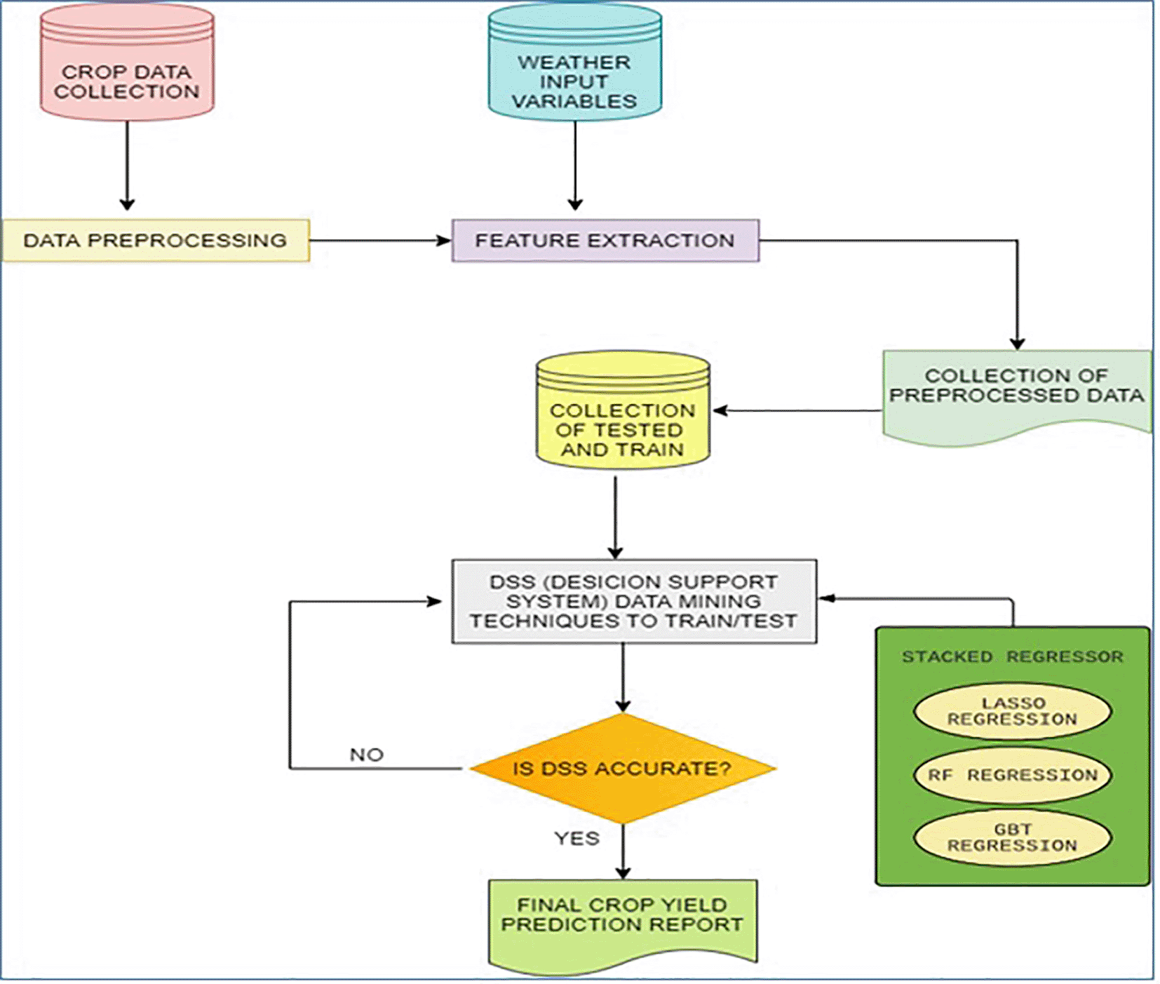
DESIGN AND METHODOLOGIES
MODULE 1: DECISION TREE

Slide 12
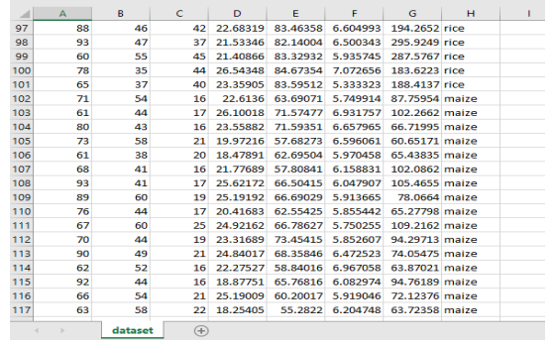
MODULE 1: COLLECTION AND PROCESSING OF DATA
Step:1 Collection of data:
The demand for agriculture food production is increasing rapidly and without using modern technologies, chances are less to meet the agriculture demand. The machine learning technologies has gained positive accuracy factor . The project reviews LR algorithm in predicting crop yield by using the parameters. The dataset are stored in the csv format. Supervised machine learning model logistic regression is used to train the desired dataset.

Slide 13
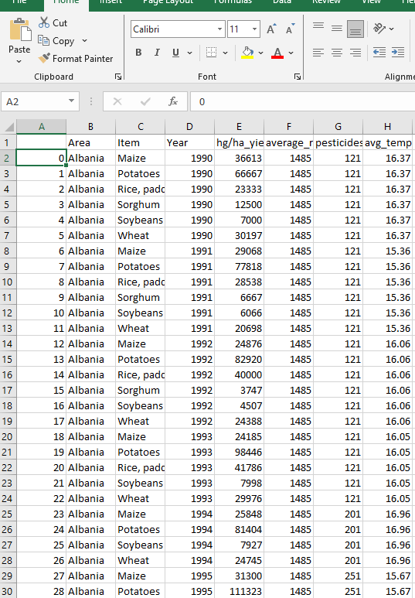
Step 2: Processing the data
Collecting the data related to various crops and areas to get the information about various factors like item harvesting, temperature, pesticides used and average yield.

Slide 14
Module 2- Machine Learning Algorithms
.
Logistic Regression:
Logistic regression models the relationship between the target variable (e.g., water quality parameter) and the independent variables (features) using a linear equation. It is a simple and interpretable algorithm but may not capture complex nonlinear patrn.
2.Decision Trees:
Decision trees recursively split the data based on features to make predictions. They can capture complex relationships in the data and are easy to understand. Random Forest, an ensemble of decision trees, is often used to improve predictive performance.
3.Random Forest:
Random Forest is an ensemble learning method, meaning it builds a model by combining the predictions of multiple base models. In the case of Random Forest, the base models are decision trees.
4.K-Nearest Neighbors (KNN):
KNN is a non-parametric algorithm that makes predictions based on the majority class of its k-nearest neighbors. It is simple to implement and can be effective for small to medium-sized datasets.
4.K-Nearest Neighbors (KNN):
KNN is a non-parametric algorithm that makes predictions based on the majority class of its k-nearest neighbors. It is simple to implement and can be effective for small to medium-sized datasets.

Slide 15
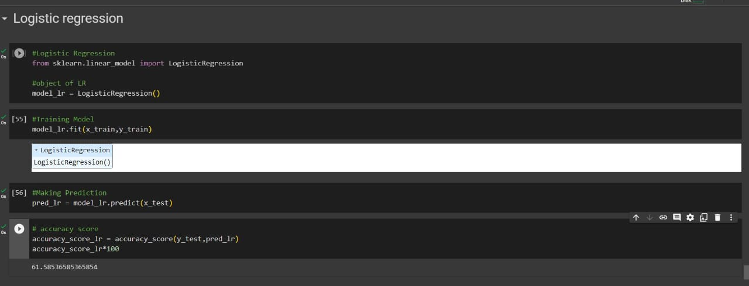
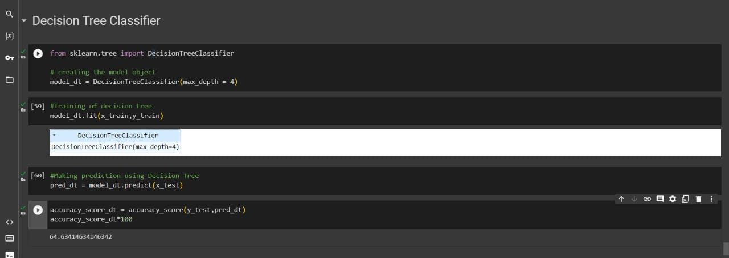
Step 3: Using algorithm’s name algorithm
FIG 1 : LOGISTIC REGRESSION
FIG 2: DECISION TREE CLASSIFIER

Slide 16
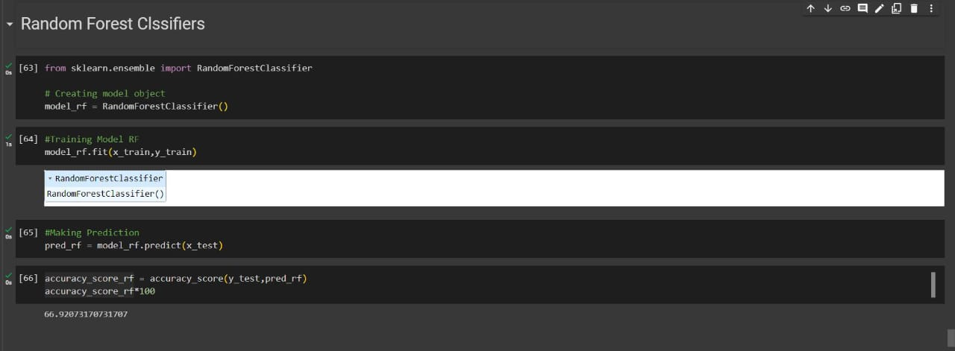
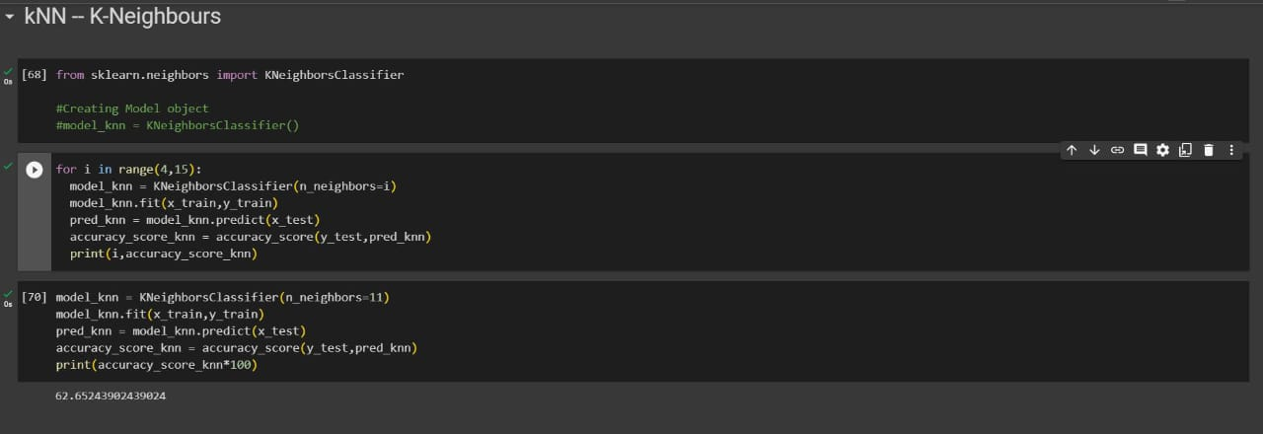
FIG 3: RANDOM FOREST CLASSIFIERS
FIG 4: K- NEAREST NEIGHBOURS

Slide 17
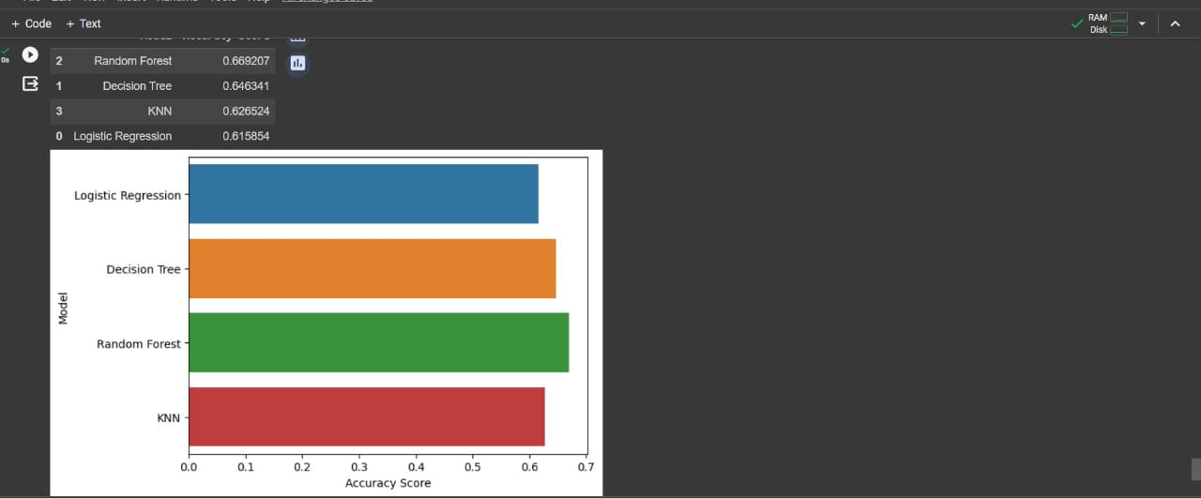
Step 4: The output
FIG 1: OUTPUT FOR ALGORITHMS

Slide 18
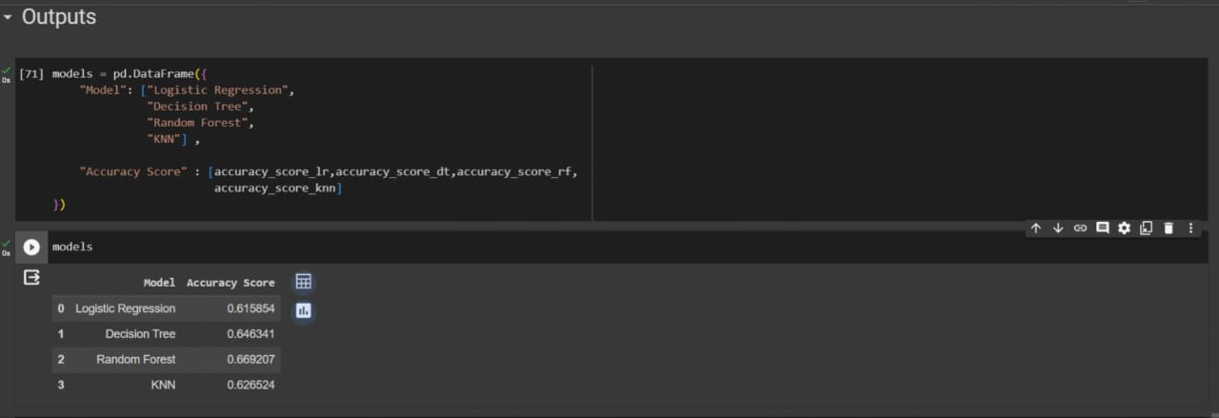
FIG 2 : OUTPUT FOR ALGORITHMS

Slide 19
IMPLEMENTATION
Architecture Diagram
Data –Flow Diagram
Use Case Diagram
Class Diagram
Activity Diagram
Sequence Diagram
Collaboration Diagram(If applicable)
E-R Diagram

Slide 20
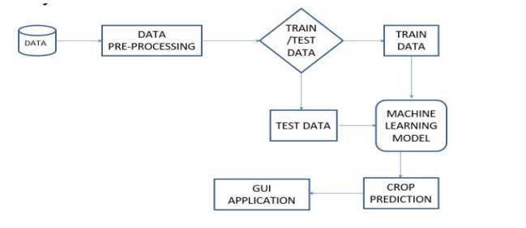
Architecture Diagram
Datasets are used in the comma-separate value(csv) format. The data set are taken from the government website data.govt.in that consist of temperature, pH, rainfall, nitrogen and other factor values. The training dataset is a portion of our actual dataset that is fed into the machine learning model to discover and learn pattern. The information preprocessing is used to improve the quality of data and to make it more suitable for specific data mining task. The standardization which convert data into a standard format that computer can easily understand and use. The supporting configuration is for reading the format and finally grouped together to get a output.
Fig: Architecture Diagram

Slide 21
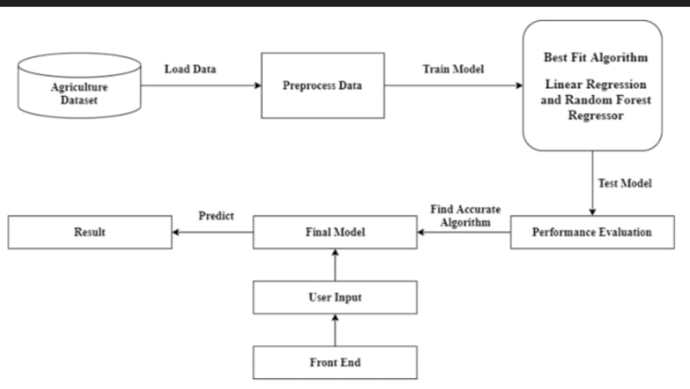
Data –Flow Diagram
The Data Flow Diagram for the efficient crop yield prediction on weather condition project outlines the flow of information and activities within the system. At the center of the diagram is the main process, which represents the core functionality of predicting weather condition. External entities, such as Users and Sensor Stations, interact with the system. Users input data, including historical weather conditions samples and information about the sensor stations they monitor. These inputs are then processed by the system, which involves activities like feature selection, model training, and prediction generation.
Fig: Data-Flow Diagram

Slide 22
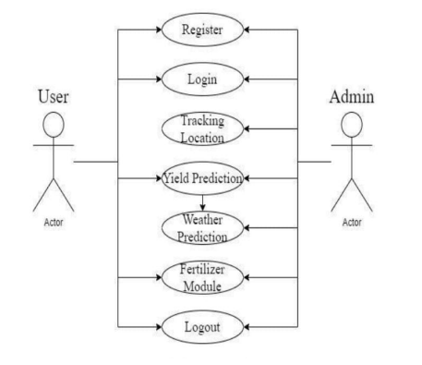
Use Case Diagram
Fig: Use Case Diagram

Slide 23
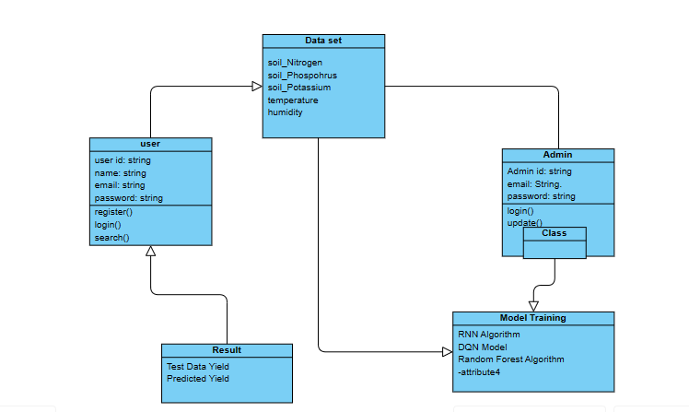
Class Diagram
Fig: Class Diagram

Slide 24
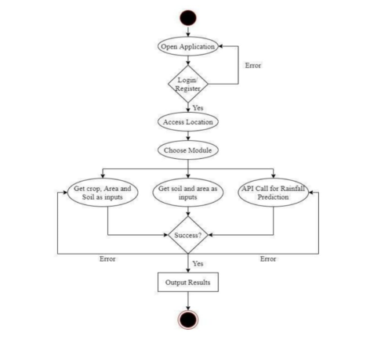
Activity Diagram
Fig: Activity Diagram

Slide 25
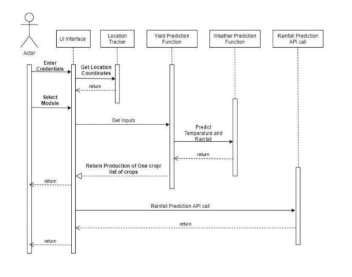
Sequence Diagram
Fig: Sequence Diagram

Slide 26
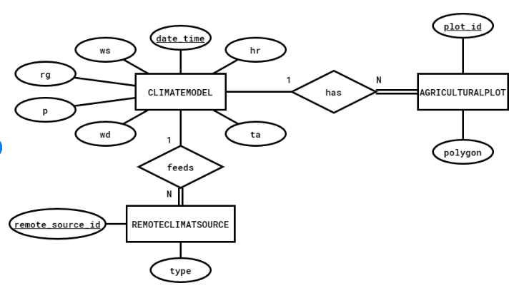
E-R Diagram
Eg,
Fig: E R Diagram

Slide 27
TESTING
UNIT TESTING
INTEGRATION TESTING
FUNCTIONAL TESTING
SYSTEM TESTING

Slide 28
UNIT TESTING
In unit testing, the design of the test cases is involved that helps in the validation of the internal program logic. The validation of all the decision branches and internal code takes place. After the individual unit is completed it takes place. Plus it is taken into account after the individual united is completed before integration. The unit test thus performs the basic level test at its component stage and test the particular business process, system configurations etc. The unit test ensures that the particular unique path of the process gets performed precisely to the documented specifications and contains clearly defined inputs with the results which are expected.
INTEGRATION TESTING
These tests are designed to test the integrated software items to determine whether if they really execute as a single program or application. The testing is event driven and thus is concerned with the basic outcome of field. The Integration tests demonstrate that the components were individually satisfaction, as already represented by successful unit testing, the components are apt and fine. This type of testing is specially aimed to expose the issues that come-up by the component’s combination.

Slide 29
SYSTEM TESTING
System testing, as the name suggests, is the type of testing in which ensure that the software system meet the business requirements and aim. Testing of the configuration is taken place here to ensure predictable result and thus analysis of it. System testing is relied on the description of process and its flow, stressing on pre driven process and the points of integration. Integration tests demonstrate that al-though the components were individually satisfaction, as shown by successfully unit testing, the combination of components is correct and consistent. Integration testing is specifically aimed at exposing the problems that arise from the combination of components.
FUNCTIONAL TESTING
The functional tests help in providing the systematic representation that functions tested are available and specified by technical requirement, documentation of the system and the user manual.

Slide 30
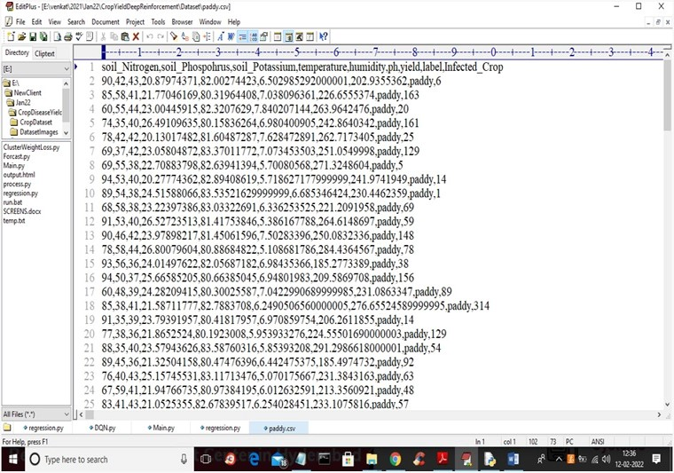
INPUT AND OUTPUT

Slide 31
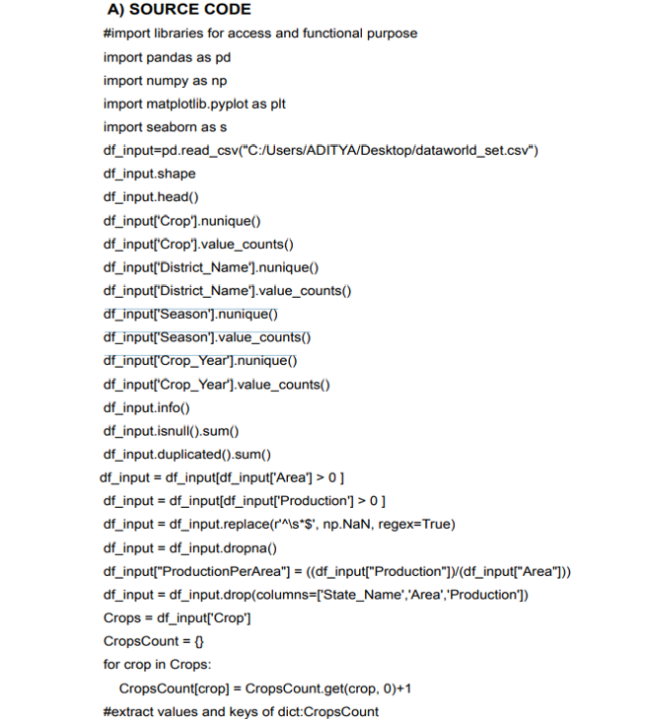
SOURCE CODE

Slide 32
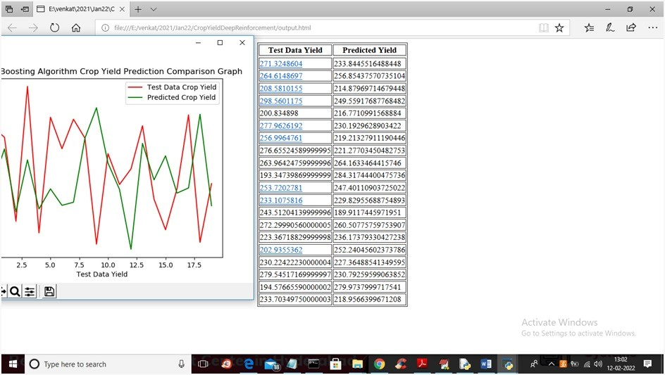
OUTPUT

Slide 33
CONCLUSION
Mention aim and problem statement
CONCLUSION:
The crop selection system to select crops for the yield based on predicted weather parameter. Logistic regression algorithm is used for the prediction model, the crop yield prediction and its accuracy of prediction is obtained of about 97%. The proposed techniques helps the farmer in decision making of which crop should cultivate in the field. The future is bright with the implementation of machine learning algorithms in the field of crop production and we hope to implement more advanced algorithms so that the system becomes more efficient and will give high accuracy
.

Slide 34
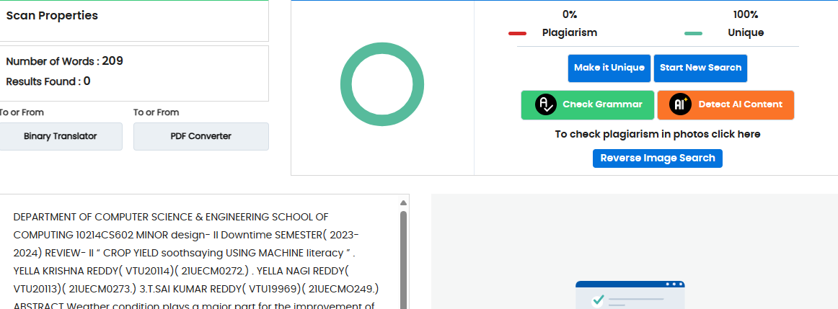
Plagiarism Report of PPT

Slide 35
Web references/video links
https://towardsdatascience.com/machine-learning-basics-part-1-a36d38c7916
https://healthcare.ai/machine-learning-versus-statistics-use
https://medium.com/fintechexplained/machine-learning-algorithm-comparisonf14ce372b855
https://dataaspirant.com/2017/05/22/random-forest-algorithm-machine-learing/
https://scikitlearn.org/stable/modules/generated/sklearn.ensemble.RandomForestClassifier.html
https://openweathermap.org/api/onecallapi?gclid=CjwKCAjwtL2BRA_EiwAacX32SzjPujH29VetWiBl-xcyG9Dw17xto02vSwkxdTFeIR18tr5GF- 8vxoC2- kQAvD_BwE
https://ukdiss.com/examples/rainfall-prediction-machine-learning.php
https://iopscience.iop.org/article/10.1088/1748-9326/aae159
https://en.wikipedia.org/wiki/Agriculture_in_India
https://www.agricultureinformation.com/forums/threads/agriculture-in-india.101537/

Slide 36
REFERENCES
[1] L. Madhusudhan, “Agriculture role on indian economy,” Business and Economics Journal, vol. 6, no. 4, p. 1, 2019.
[2] V. Kumar, V. Dave, R. Bhadauriya, and S. Chaudhary, “Krishimantra: agricultural recommendation system,” in Proceedings of the 3rd ACM Symposium on Computing for Development. ACM, 2021, p. 45.
[3] A. Srinivasan, Handbook of precision agriculture: principles and applications. CRC press, 2022.
[4] K. Kaur, “Machine learning: applications in indian agriculture,” International Journal of Advanced Research in Computer and Communication Engineering, vol. 5, no. 4, pp. 342–344, 2020.

Slide 37
THANK YOU

